Slide 1

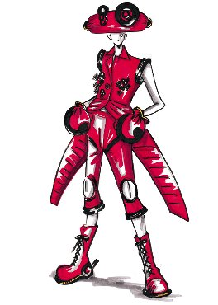
Perceptual User Interfaces
David Rashty
Notes:
Notes on the picture:
The color and size of this ensemble can be converted according to the wearer's preferences – All he has to do is insert her coded ID card in the waist pocket to engage the starter. He can select or install new preferences.
The hat in the picture contains a solar array for powering a cell phone.
A navigational system is housed in a chest brooch to steer her in the right direction.
Knee lights are made of monitor fabric.
Expandable options inflate the shoulders and pants like airbags for different "looks."

Slide 2
“Good bye keyboard, so long mouse. Hello smart rooms and clothes that recognize acquaintances, understand speech, and communicate by gesture.
And that’s just the beginning… ”
Alex Pentland

Slide 3

User Interfaces
A user interface is the junction between a user and a computer program.
An interface is a set of commands or menus through which a user interacts with a program.
The user interface is one of the most important parts of any program because it determines how easily you communicate with the computer. A complex program with a poorly designed user interface has little value.

Slide 4
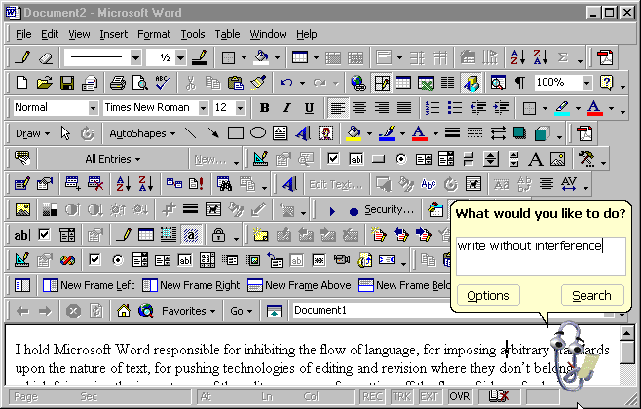
User interfaces should be simple to use…

Slide 5
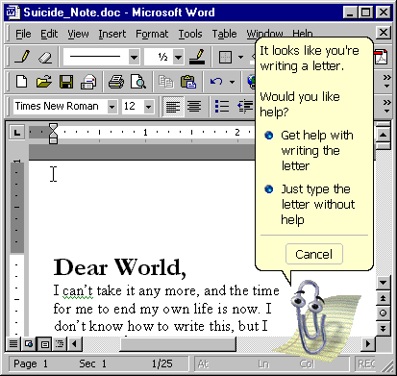
and smart!

Slide 6
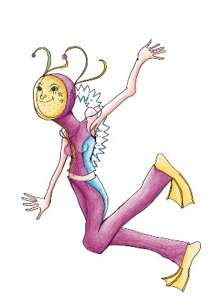
Perceptual User Interfaces (PUI)
Most users interact with computers by typing, pointing, and clicking. This is the current design paradigm.
Human interaction on the other hand is a multimodal activity: each sense plays an important role in the communication process.
PUIs are characterized by interaction techniques that combine understanding of natural human capabilities (human senses) with machine perception and reasoning.

Slide 7
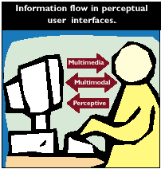
Types of interfaces
Multimedia – Uses perceptual and cognitive skills to interpret information presented to the user.
Multimodal – Emphasizes human communication skills. We use multiple modalities when we communicate, leading to a more effective interaction.
Perceptive – One that adds human-like perceptual capabilities to the computer.

Slide 8
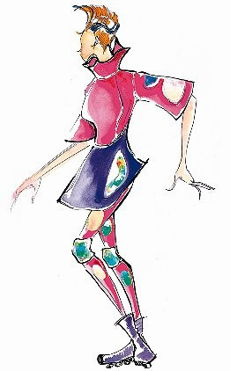
PUI in everyday life
Voice recognition in cellular phones (Samsung)
Voice recognition in word processors (Macintosh)
Voice recognition in answering machines
Robotics: lawnmower, automated assembly line
Medicine: body condition with autonomous sensors
Sports: updated information to sportsmen
Simple interfaces: automatic doors and light bulbs
Notes:
What's the perfect working outfit for a documentary film-maker? Monitor wear, of course. History happens everywhere all at once and Rosa doesn't miss a minute of it sitting in a dark and dreary editing room. With monitor wear she can connect her video equipment to her clothing. She can view rushes—even edit on the move—and whether her subject is a group of Tibetan Nomads, or truck drivers in the Southwestern US, being on the move is the status quo.
Some of the panels can be used for video editing functions, while others might be playing a previous piece of her work—or even serve as a computer interface or television receiver. Washable and comfortable, this is the clothing for the real live wire.
Don't feel like making a projection of yourself today? The panels can enliven the design of the dress by showing changing patterns and colors, or even static images.
These dresses have been created as a proposal for the future realization of a wearable monitor. Monitor fabric technology has not yet caught up with our vision, so we have substituted holographic fabrics for this display. We hope that with continuing research into conductive fabric technologies, our imagination may soon be eclipsed by reality.

Slide 9
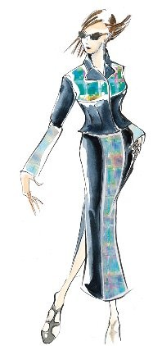
Robotics – some simple tasks
Moving objects (movie)
Can rotation (movie)
Changing light bulbs (movie)
Walking around obstacles (movie)
Notes:
What's the perfect working outfit for a documentary film-maker? Monitor wear, of course. History happens everywhere all at once and Rosa doesn't miss a minute of it sitting in a dark and dreary editing room. With monitor wear she can connect her video equipment to her clothing. She can view rushes—even edit on the move—and whether her subject is a group of Tibetan Nomads, or truck drivers in the Southwestern US, being on the move is the status quo.
Some of the panels can be used for video editing functions, while others might be playing a previous piece of her work—or even serve as a computer interface or television receiver. Washable and comfortable, this is the clothing for the real live wire.
Don't feel like making a projection of yourself today? The panels can enliven the design of the dress by showing changing patterns and colors, or even static images.
These dresses have been created as a proposal for the future realization of a wearable monitor. Monitor fabric technology has not yet caught up with our vision, so we have substituted holographic fabrics for this display. We hope that with continuing research into conductive fabric technologies, our imagination may soon be eclipsed by reality.

Slide 10
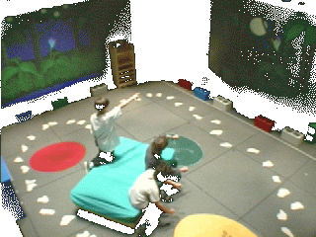
The Kids Room
The KidsRoom is an automated and interactive narrative playspace for children. It uses computer vision action recognition simultaneously with computerized control of images, video, light, music, sound, and narration to guide children through a storybook adventure.
Notes:
http://vismod.www.media.mit.edu/vismod/demos/kidsroom/kidsroom.html

Slide 11
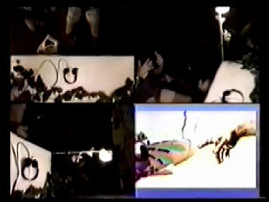
A model for language acquisition (movie)

Slide 12
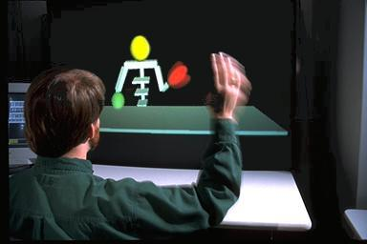
Lyco
This system uses camera observations to draw a dynamic model of human’s motion. The model chooses typical behaviors when it is necessary to choose among multiple physically possible trajectories. This system has been integrated into applications ranging from physical rehabilitation to dance classes.
Notes:
If we hope to build computers that help people, we must build computers that are able to understand people. One step is the ability to understand human activity. Human motion is a very complex phenomenon, but it is not entirely arbitrary. The physical limitations of the body, the patterns encoded into our physiological structures, and even the habits of motion that we acquire over time, all combine to provide strong constraints on how we move. Modeling these constraints is an important step toward eventual understanding.

Slide 13
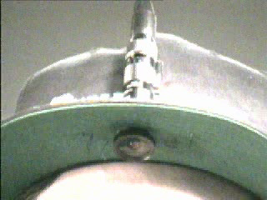
Sign language recognition (movie)
This system uses a camera pointed down from the a baseball cap to track the wearer's hands in real time and interpret American Sign Language (ASL) and translate it into English.

Slide 14
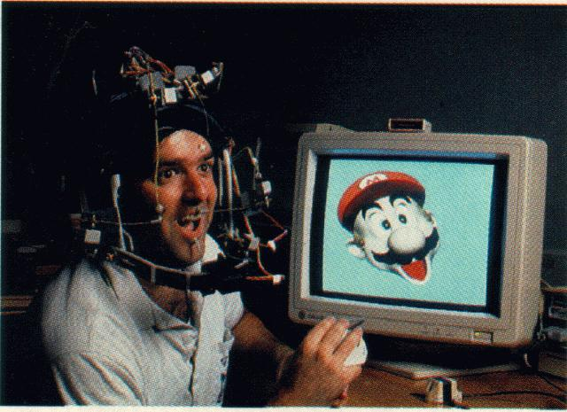
Face recognition
In 1994…
Interfaces that understand the way users feel and act enhance the interaction between man and machine by responding to situations in a continuous and particular way.
By recognizing how a student feels a training program can decide the best method to continue the program.

Slide 15
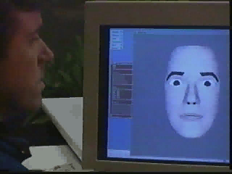
Face recognition (movie)
in 2000!

Slide 16
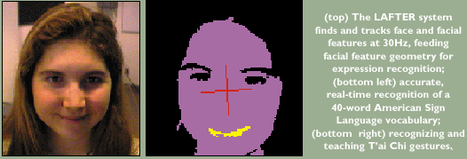
Face recognition

Slide 17
Wearable Interfaces
A wearable computer is a computer that is always with you, is comfortable and easy to keep and use, and is as unobtrusive as clothing. Wearable computers have the following characteristics:
Portable while operational: it can be used while walking or otherwise moving around.
Hands-free use
Sensors: A wearable should have sensors for the physical environment.
"Attention-getting": A wearable should be able to convey information to its user even when not actively being used.
Always on: By default a wearable is always on and working, sensing, and acting.
Notes:
To date, personal computers have not lived up to their name. Most machines sit on the desk and interact with their owners for only a small fraction of the day. Smaller and faster notebook computers have made mobility less of an issue, but the same staid user paradigm persists. Wearable computing hopes to shatter this myth of how a computer should be used. A person's computer should be worn, much as eyeglasses or clothing are worn, and interact with the user based on the context of the situation. With heads-up displays, unobtrusive input devices, personal wireless local area networks, and a host of other context sensing and communication tools, the wearable computer can act as an intelligent assistant, whether it be through a Remembrance Agent, augmented reality, or intellectual collectives.
A wearable computer is a computer that is always with you, is comfortable and easy to keep and use, and is as unobtrusive as clothing. A more specific definition is that wearable computers have the following characteristics: Portable while operational: The most distinguishing feature of a wearable is that it can be used while walking or otherwise moving around. Hands-free use Sensors: A wearable should have sensors for the physical environment. Such sensors might include wireless communications, GPS, cameras, or microphones. "Attention-getting": A wearable should be able to convey information to its user even when not actively being used. For example, if your computer wants to let you know you have new email and who it's from, it should be able to communicate this information to you immediately. Always on: By default a wearable is always on and working, sensing, and acting.

Slide 18
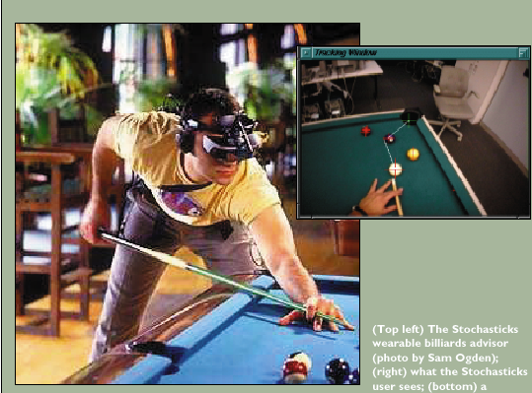

Slide 19
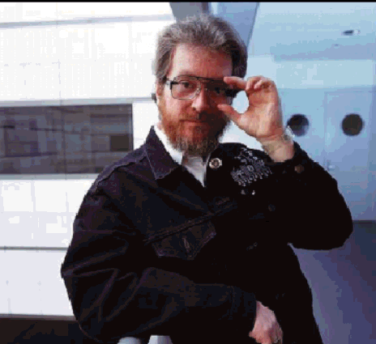
Alex Pentland wearing a variety of new devices:
The glasses contain a computer display nearly invisible to others.
The jacket has a keyboard embroidered into the cloth.
The lapel has a context sensor that classifies the user’s surroundings.

Slide 20
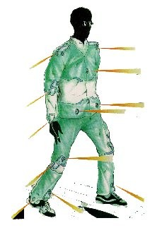
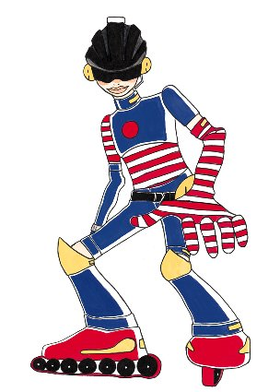
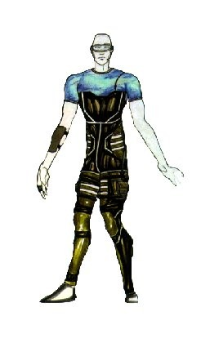
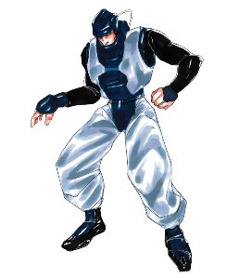
Perceptual Fashion Show
The sensors embedded in this clothing allow the user to move with ease. The sonar sensors detect objects within one to four meters, vibrating to indicate the direction and proximity of objects.
The helmet contains earphones for the reception of parental messages, music, and missives from friends and a homing device that is coordinated with a receiver at home.
The suit, which is thermo-regulated, captures energy as the user walks. It also features a microphone in the collar, a gyroscopic mouse in one of the gloves, and sensors that monitor his physiology.
The policeman headset contains a mini-camera, located in his visor. With the aid of his optical mini-mouse he can send images to the central, where a search can match the images with criminals.

Slide 21
Perceptual versus Graphical User Interfaces
GUI | PUI
Input is atomic and certain | Input such as speech and gesture is uncertain
Assume a sequence of discrete events such as mouse clicks | Must process two or more continuous input streams that frequently are delivered simultaneously
Notes:
PUI – Perceptual User Interfaces
GUI – Graphical User Interfaces

Slide 22
How does it work? - Quickset
Quickset enables a user to create and position on a map with speech, pen-based gestures or direct manipulation.
Input signals are processed in parallel and recognition results are generated for each modality.
The multimodal integration combines symbolic and statistical information to enhance system robustness.
If more than one interpretation is successfully integrated then the final interpretation is resolved from statistical rankings.
The application bridge confirms the system’s interpretation with the user and sends it to the appropriate application.
User Input
Speech Recognition
Gesture Recognition
Spoken Language Interpretation
Gestural Language Interpretation
Multimodal Integration
Application Bridge

Slide 23
Conclusions
Perceptual interfaces are an emerging technology that offer expressive, transparent, and mobile human computer interaction.
Perceptual interfaces are strongly preferred by users since it turns computer interaction into a much more natural and intuitive activity.
Their increasingly sophisticated design and implementation are an important key to shifting the balance of human-computer interaction much closer to the human.

Slide 24
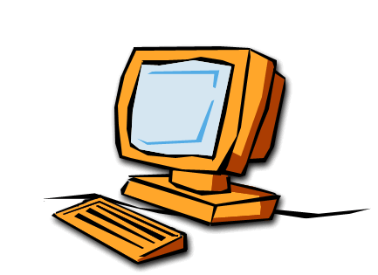
Research directions
A usable environment that understands the user’s needs and acts accordingly.
Smart clothes, rooms, spaces
A sensitive environment
that can help users to deal
with sentimental problems and difficulties.
Affective Computing

Slide 25
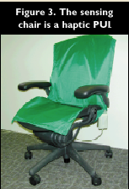
In the future…
Displays that know if you are watching them
Credit cards that recognize their owners
Chairs that adjust to keep you awake and comfortable
Shoes that know where they are

Slide 26
References
Journal of the ACM:
  http://www.acm.org
MIT media laboratory:
  http://lcs.www.media.mit.edu/projects/wearables
  http://www.media.mit.edu
Events:
  http://www.research.microsoft.com/PUIWorkshop

Slide 27
“We imagine building a world where the distinction between inanimate and animate objects blur, and the objects that surround us become more like helpful assistants or playful pets than insensible tools”
Alex Pentland

